Slide 1
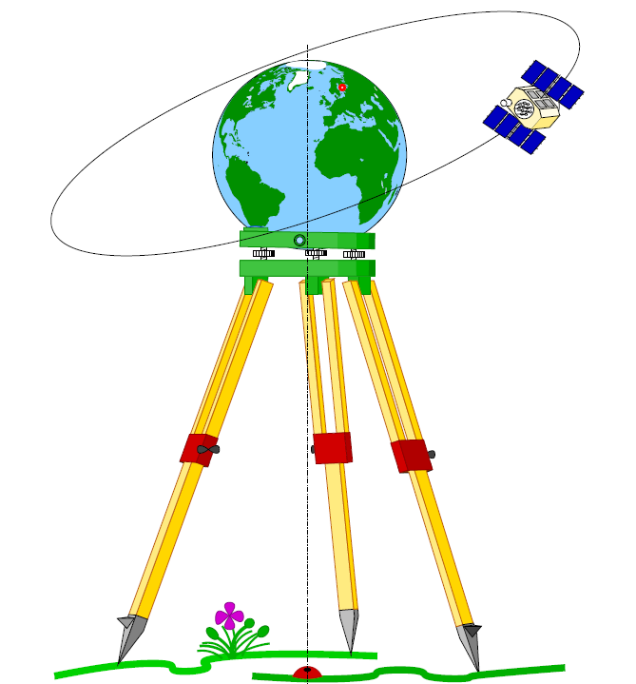
Geodesy

Slide 2
Coordinate Systems in Geodesy
There are different types of coordinate systems depends on the reference datum (Ellipsoid) used for the reduction of observations taken on the physical surface of the earth.
These Datums used for computation of positions or locations [coordinates; latitudes and longitudes or X, Y.

Slide 3
Coordinate Systems in Geodesy
Astronomical coordinate system as historical background (ɸ, ᴧ, H)
Geographic or geodetic or ellipsoidal coordinate system (ϕ, λ, h)
Cartesian geodetic coordinate system (x, y, z)
Local cartesian coordinate system (ux, uy, uz)

Slide 4
(1) Astronomical coordinate system
fundamental quantities in geodetic astronomy namely, the astronomic latitude (ɸ), astronomic longitude (ʌ), and orthometric height (H)
Astronomic latitude (ɸ) is defined as the angle between the astronomic normal (gravity
Vertical; tangent to the plumb line at the point of interest; and the plane of the instantaneous
equator measured in the astronomic meridian
plane.

Slide 5
Astronomic longitude (ᴧ) is the angle between
the Greenwich Mean Astronomic Meridian and
the astronomic meridian plane measured in the
plane of the instantaneous equator.
The orthometr1c height (H), is the height of the
point of interest above the geoid, measured
along the plumb line, as obtained from
leveling and enroute في المسار gravity
Observations.

Slide 6
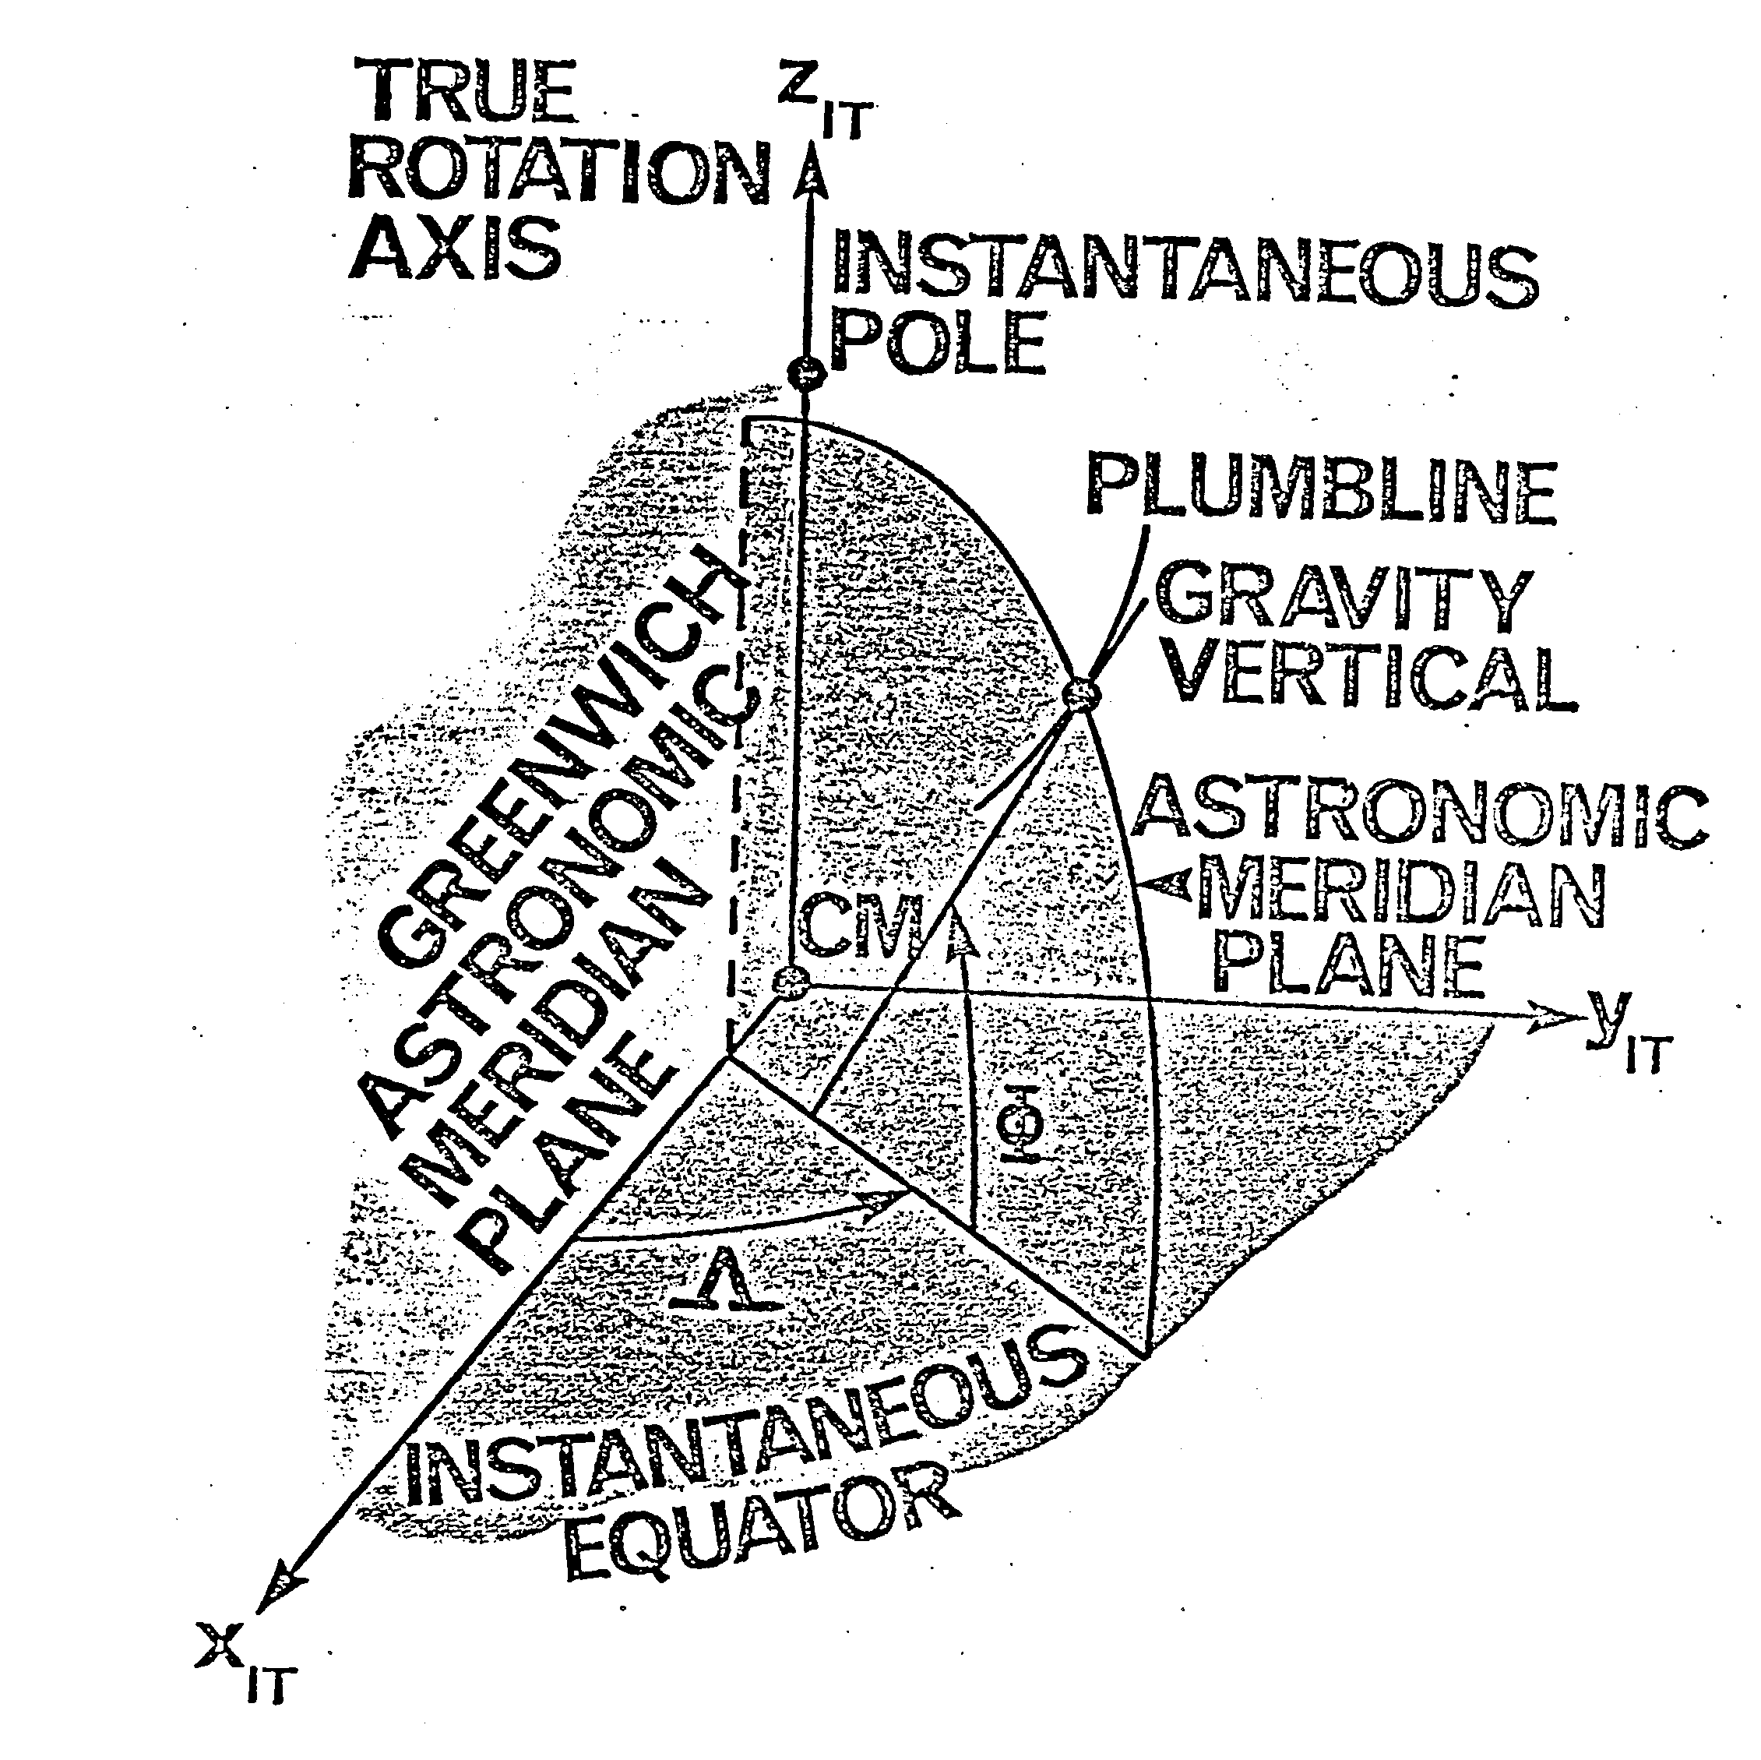

Slide 7
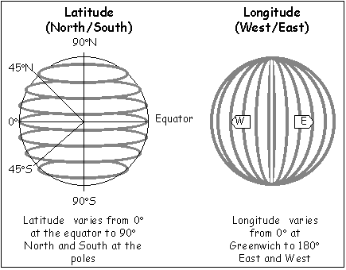
(2) Geographic (Geodetic) Coordinate system

Slide 8
Origin (o) of the system is the centre of gravity of the earth (C.G).
X-axis is the direction from o to the intersection of equator with the Greenwich Meridian.
Z-axis coincide with the rotation’s axis of the earth.
Y-axis complete the right handed system.
Geodetically, any point on the earth’s surface defined by its geodetic latitude (ϕ), geodetic longitude (λ) and geodetic height (h).
These coordinates can be obtained from the conversion of astronomic coordinates (ɸ, ʌ, H) or from GPS measurements.

Slide 9
Geodetic latitude (ϕ)
The geodetic latitude ϕ is the angle between the
direction of the normal to the ellipsoid at any point
and the equatorial plane. It varies from 0⁰ to 90⁰ N
and 90⁰ S
Geodetic longitude (λ)
The geodetic longitude (λ) of any point is the
dihedral angle between the plane of the prime
meridian (meridian of Greenwich) and the meridian
passing through this point. Its value will be +ve in
the east (E) and -ve in the west (W).

Slide 10
Geodetic Height (h)
The Geodetic Height (h) of any point is the
vertical distance measured along the normal to
the ellipsoid at this point from the earth’s
surface to its projected point on the ellipsoidal
surface.

Slide 11
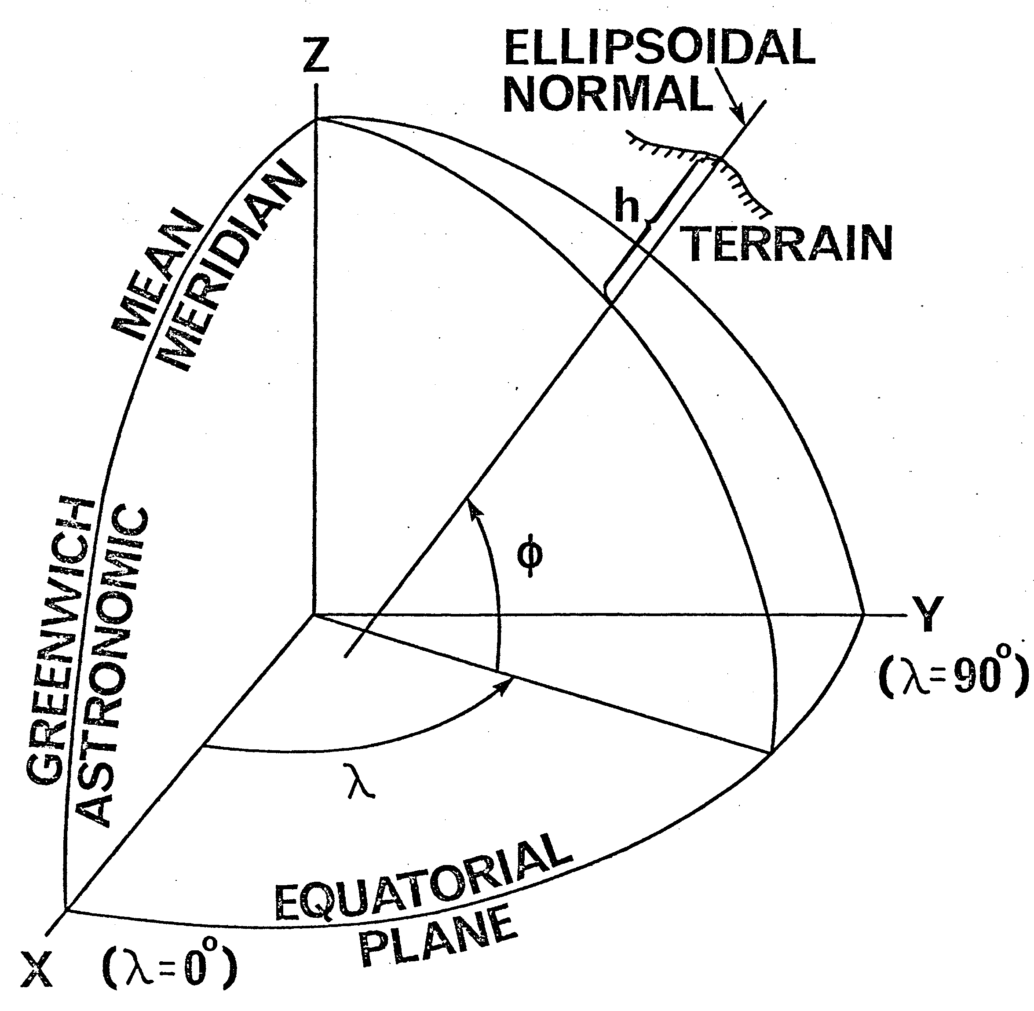

Slide 12
